Slide 1
Change the font size of sql editor
Milind Parab

Slide 2
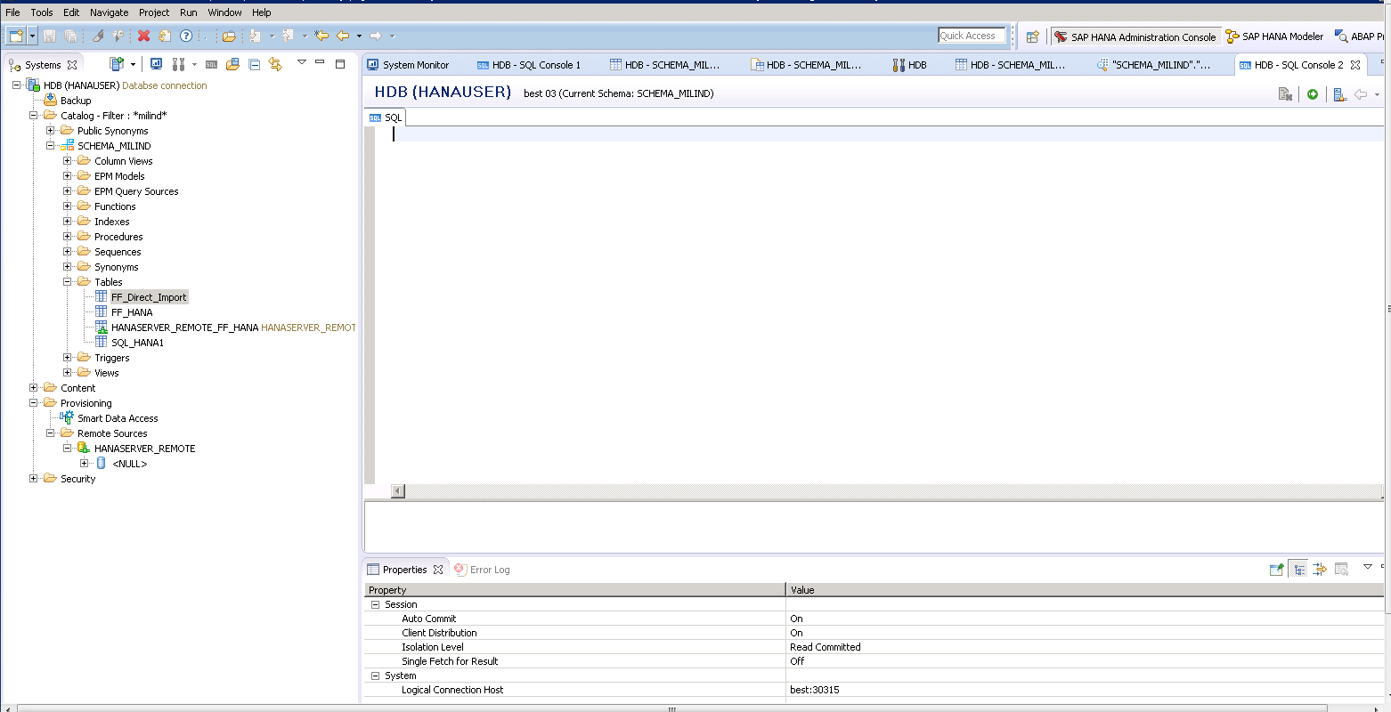
Open SQL console.

Slide 3
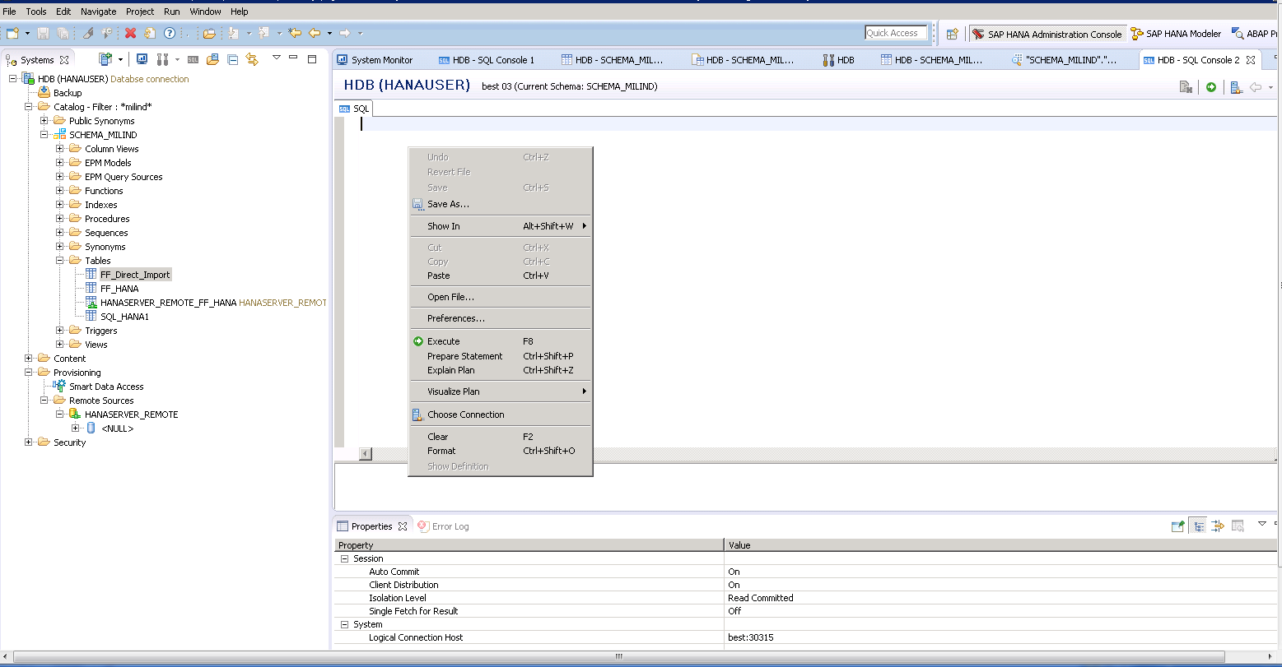
Right click inside blank area of console and click on preferences.

Slide 4
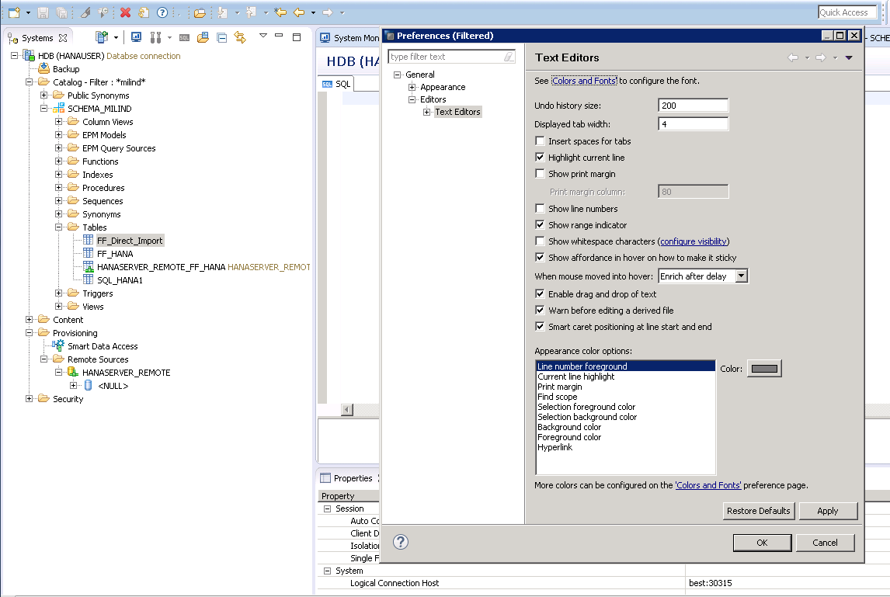
Click on color and fonts.

Slide 5
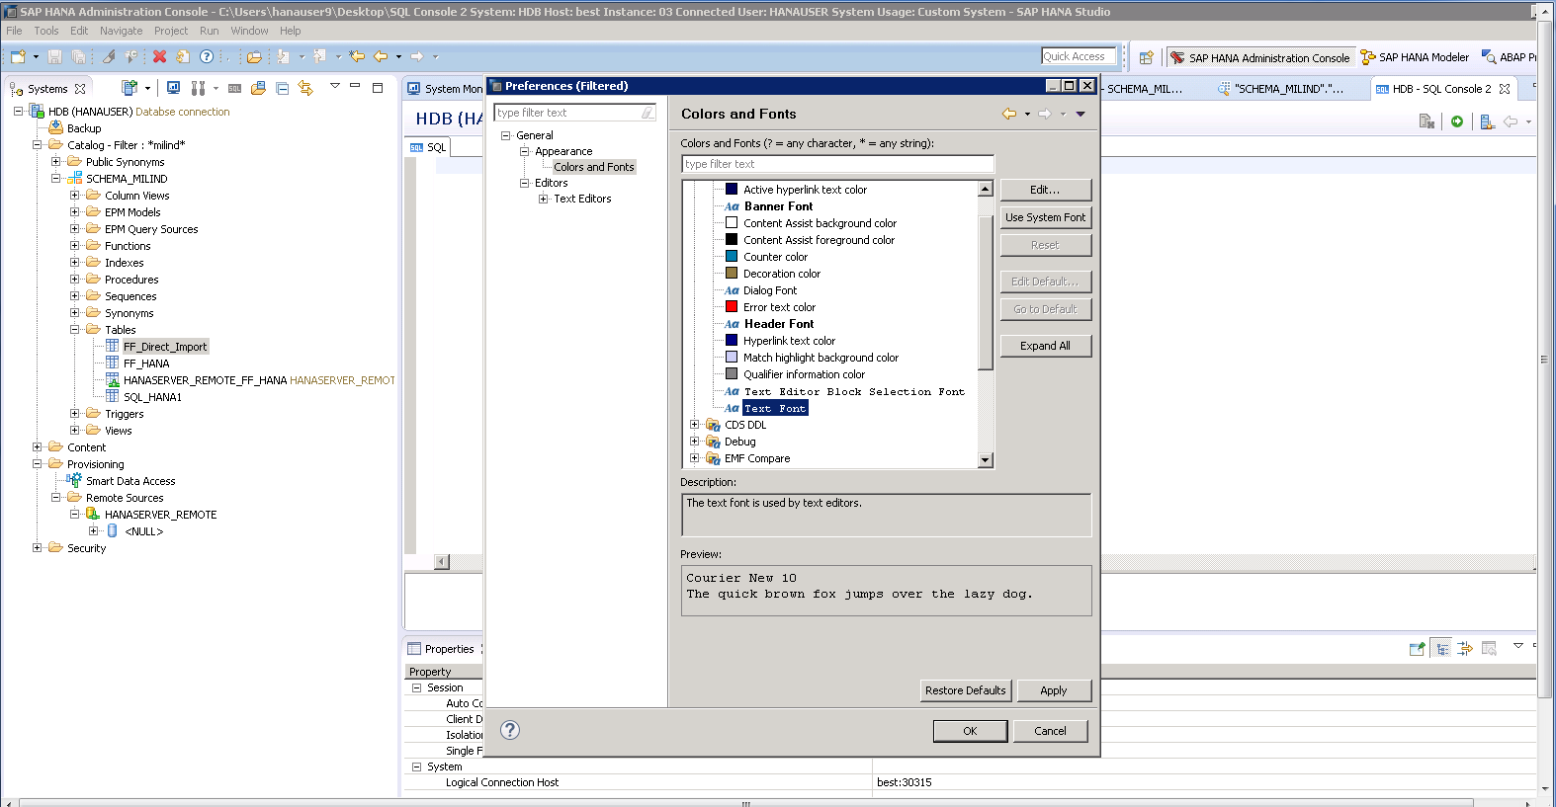
Click on Text Font.

Slide 6
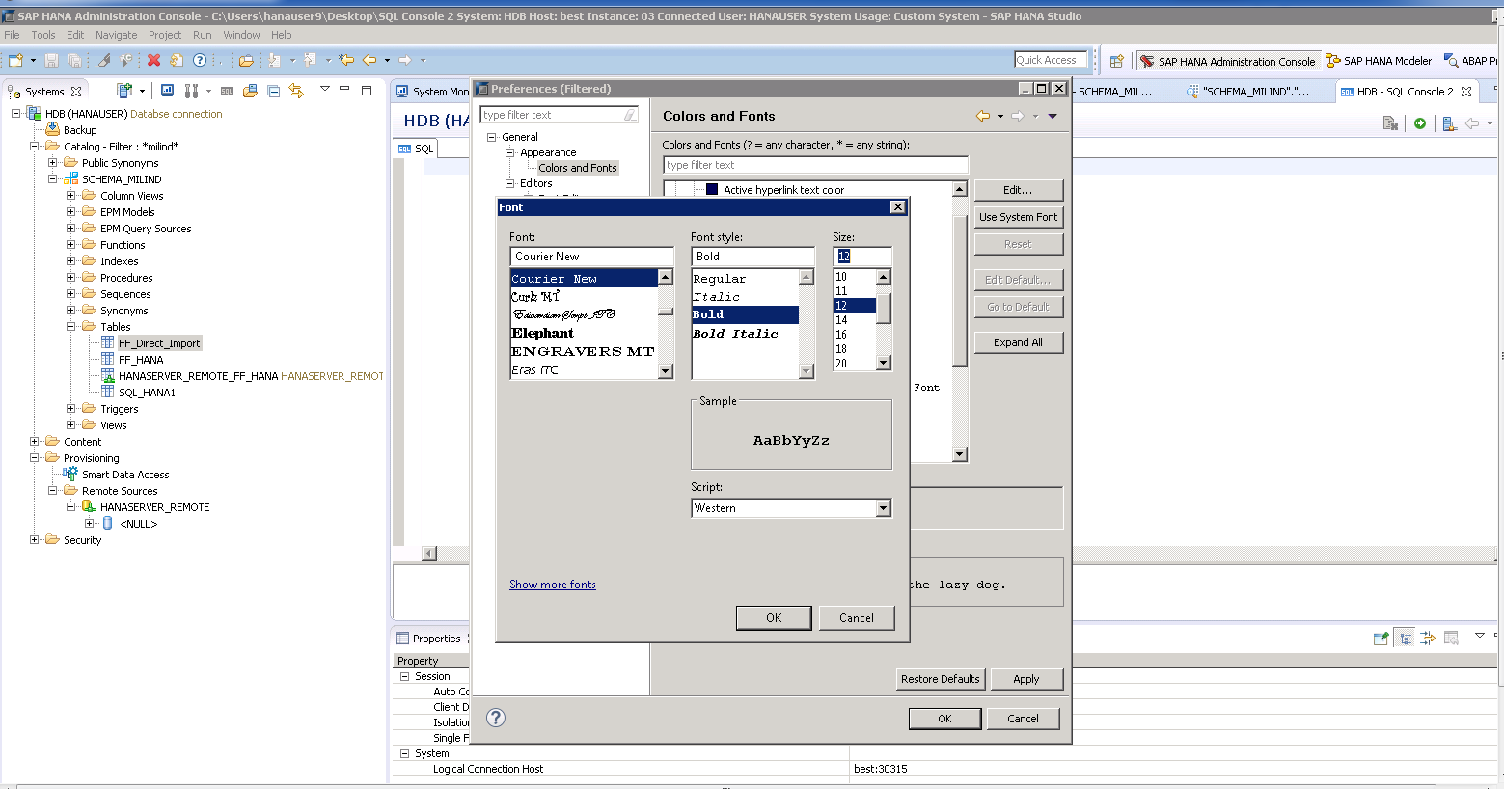
Update the font size as needed.

